Slide 1

Lab Exercise

Slide 2
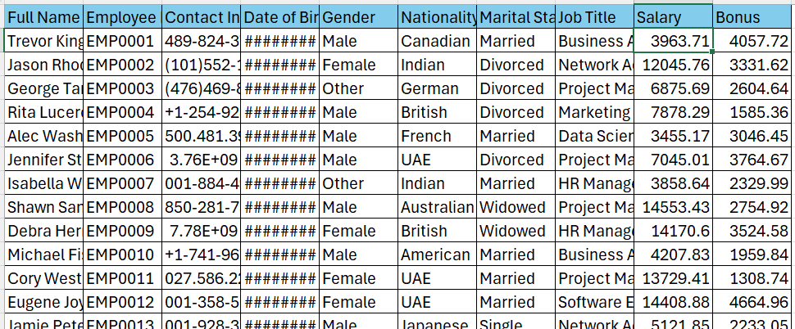
Employee Dataset

Slide 3
Tasks
1. Read the CSV file using Python
2. Create a new column 'High_Bonus’ True if Bonus > 2000, else False
3. Prepare input feature vector X and output feature vector y as
X= ['Gender', 'Nationality', 'Marital Status', 'Job Title’, ’Salary’]
y= 'High_Bonus’
4. Perform 80-20 train and test split
5. Perform classification using Bayesian classifier

Slide 4
GaussianNB
GaussianNB in sklearn refers to the Gaussian Naive Bayes classifier,
A probabilistic machine learning model used for classification tasks.
from sklearn.naive_bayes import GaussianNB
model = GaussianNB()
model.fit(X_train, y_train)
model.predict(X_encoded)

